Slide 1
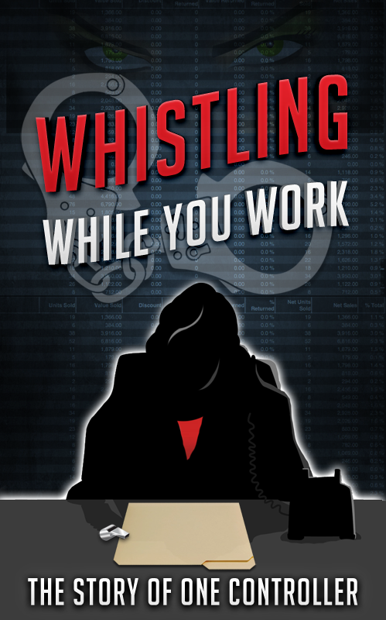

Slide 2
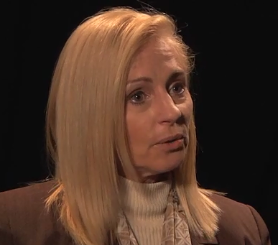
Introduction
WHISTLING WHILE YOU WOR K
Jackie McLaughlin, CPA
Former controller of mid-sized distribution company.
Pressured to commit financial statement fraud by her CFO.
Saved her career by blowing the whistle.

Slide 3
Cook the Books?
WHISTLING WHILE YOU WORK
Asked by her CFO to cook the books by:
Overstating inventory and accounts receivable.
Understating the reserve for obsolescence and the allowance for doubtful accounts.

Slide 4
The CFO’s Rationalization
WHISTLING WHILE YOU WORK
Delinquent customers would eventually pay their bills:
Our competitors have stopped shipping orders to those same customers.
The customers needed supplies to stay in business:
They had no choice but to make payments at some point in time.

Slide 5
The CFO’s Rationalization
WHISTLING WHILE YOU WORK
Old inventory was salable.
Because much of it was no longer manufactured.
Customers might need a replacement part for their clients.
The company would have it and the inventory would be sold.

Slide 6
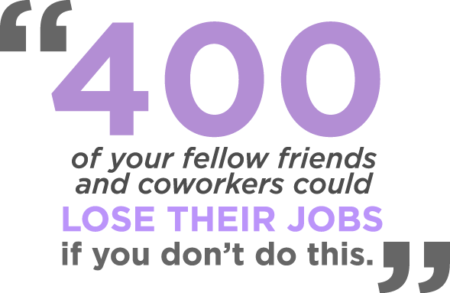
Jackie’s Dilemma
WHISTLING WHILE YOU WORK
Jackie’s CFO’s told her:

Slide 7
Jackie’s Dilemma
WHISTLING WHILE YOU WORK
These employees were not just names on a page to Jackie.
Her stress was mounting.

Slide 8
Financial Landscape
WHISTLING WHILE YOU WORK
Net income was decreasing and company-wide bottom line was out of line.
Poor expense control.
Bad inventory purchases.
Increasing accounts receivable put a constant strain on cash flow.

Slide 9
Poor Policies
WHISTLING WHILE YOU WORK
Poor expense control: Mike undercharged customers for the cost of shipping products to them.
The company was paying more in product shipping expenses than what it was actually bringing in revenue.
Bad inventory purchases: Mike would make inventory purchasing decisions for the entire company, even when his purchasing teams advised against it.
Increasing accounts receivable: With loosened credit and collections policies, Mike continued to ship to customers who didn’t pay

Slide 10
Growing Pains
WHISTLING WHILE YOU WORK
The CEO quickly increased the size of the company:
From 4 locations to 9.
From $20 million in sales to $120 million.
From 100 employees to 400 employees.
But despite this growth, the bottom line continued to suffer.

Slide 11
Accounting Problems
WHISTLING WHILE YOU WORK
The maximum available line of credit was approximately $20 million.
Limited by 50% of inventory and 80% of accounts receivable.
If inventory was $10 million and accounts receivable was $10 million, the company could borrow $13 million:
((50% of $10M = $5M) + (80% of $10M = $8M))

Slide 12
The Dilemma
WHISTLING WHILE YOU WORK
Mark’s focus:
Cut expenses
Make all existing locations profitable
Mike’s focus
Sales
Net Income
Mark answered to bankers and vendors not being paid.

Slide 13
The Dilemma
WHISTLING WHILE YOU WORK
Mike believed that cash shortages were not his problem, but Mark’s. His solution:
Qualify for bigger and bigger draws from the line of credit.
Maximize accounts receivable and inventory.
Raw balances were large enough to warrant more cash.
Many balances were comprised of delinquent accounts receivable and inventory that had been on the shelves in excess of 20 years.
The bank wanted to lend on collectible accounts receivable and salable inventory, not on delinquent balances and obsolete inventory.

Slide 14
Loan Covenants
WHISTLING WHILE YOU WORK
The loan agreement contained loan covenants which required a certain level of profitability and financial ratios indices.
Mark was concerned with:
How much could be borrowed.
How the company was performing relative to the loan covenants.

Slide 15
Accounting Tricks?
WHISTLING WHILE YOU WORK
An increase in the allowance for doubtful accounts and the reserve for obsolete inventory would have:
Pushed the company out of compliance with multiple loan covenants.
Decreased the amount available for borrowing.
Notes:
Mark was certain that would result in a large and mandatory pay down of the line of credit at best, or a loan that was called by the bank requiring payment in full at worst.
The former would result in layoffs; the latter would force a complete shutdown of operations. Neither consequence was good.

Slide 16
Accounting Tricks
WHISTLING WHILE YOU WORK
Mark’s solution:
Understate the allowance for doubtful accounts and the reserve.
Jackie refused.

Slide 17
Jackie’s Dilemma
WHISTLING WHILE YOU WORK
Jackie was directed to have no conversations with the auditors.
Mark insisted Jackie send the auditors to him for discussions.
Jackie was extremely conflicted about what to do.
She thought: Isn’t avoiding the auditors and leaving out information the same as lying?

Slide 18
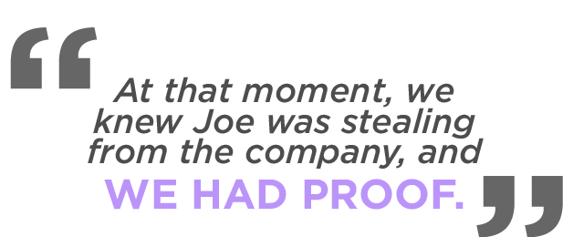
Internal Red Flags
WHISTLING WHILE YOU WORK
Employee receipts for lodging reimbursement lacked a hotel logo and appeared forged.
Petty cash fraud.
Horse racing operations.

Slide 19
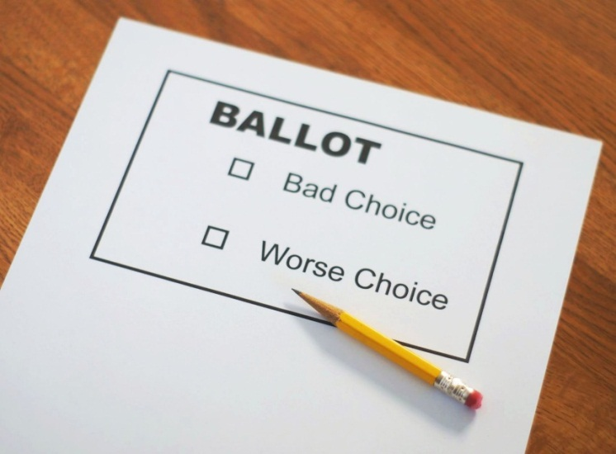
Jackie’s Reality
WHISTLING WHILE YOU WORK
400 people could to lose their jobs if she did not engage in fraud.
Being a whistle-blower could hamper her ability to be employable.
Incur retaliation from her employer in the form of:
Termination
Attacks on her character
Never-ending legal bills to defend herself.

Slide 20
The Solution: External Auditors
WHISTLING WHILE YOU WORK
Before the audit began, Jackie told the auditors the whole story.
She provided her all the information needed to uncover the fraud:
Where to look
What to ask for
What reports to examine
Who to speak with.

Slide 21
What Happened?
WHISTLING WHILE YOU WORK
Mike and Mark never found out who blew the whistle.
Jackie left the company.
She never had any regrets about leaving.
She believes that better tools should be in place for whistle-blowers.
The company still exists today.

